Slide 1
CARIBBEAN INITIATIVE

Slide 2
Collaborating partners

Slide 3
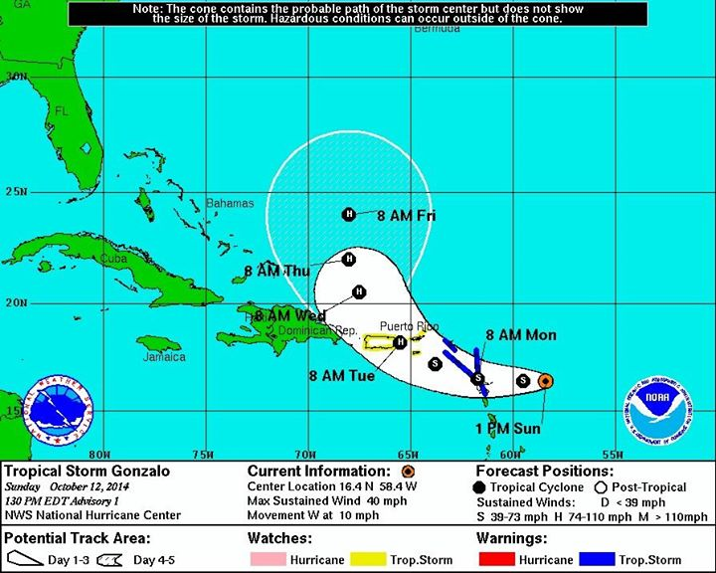
Workshop dates and location
Original dates: Oct. 14-16, 2014
New dates: January 27 – 29, 2015
Hotel villa parguera, la parguera-lajas.
All participants and speakers confirmed for new dates
CANCELED:
HURRICANE GONZALO

Slide 4
Workshop organization and participation
Workshop moderators
Carlos Velazquez
Roberto silva
Marcos Hanke
Participants enrolled
27 commercial fishers (1 usvi commercial fisher)
8 recreational fishers
2 other
37 participants total
Notes:
Other = government representatives from USCG, DNER, and Agricultura.

Slide 5
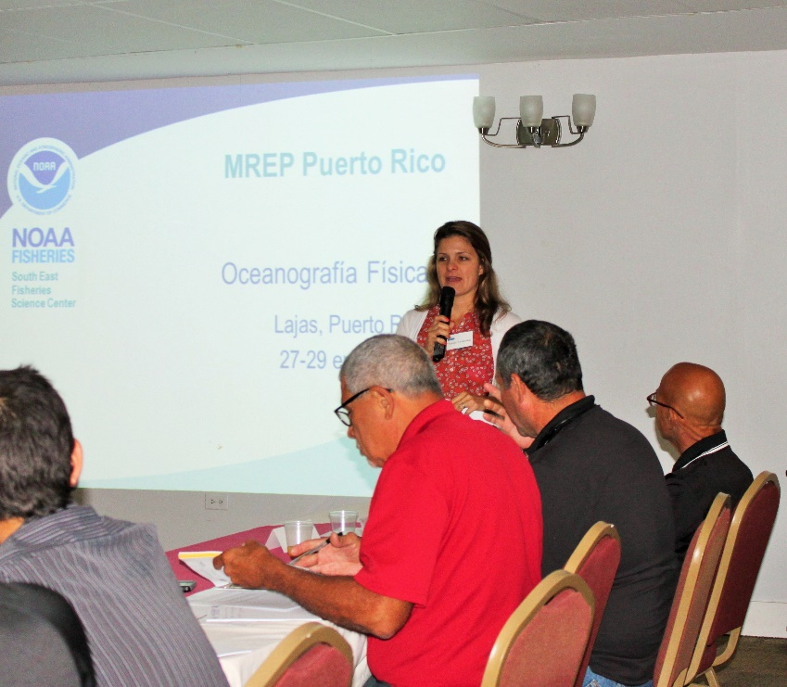
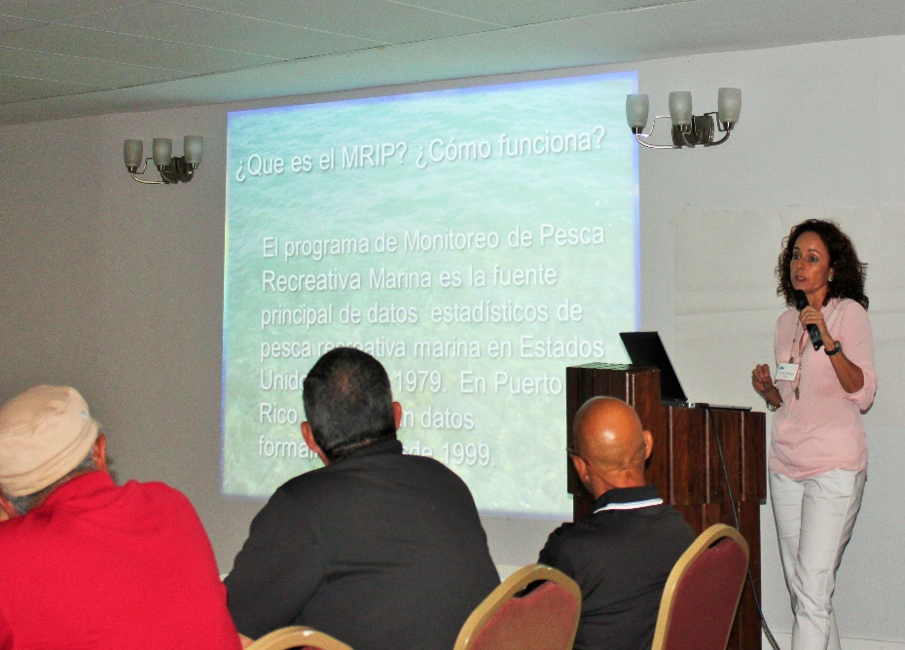
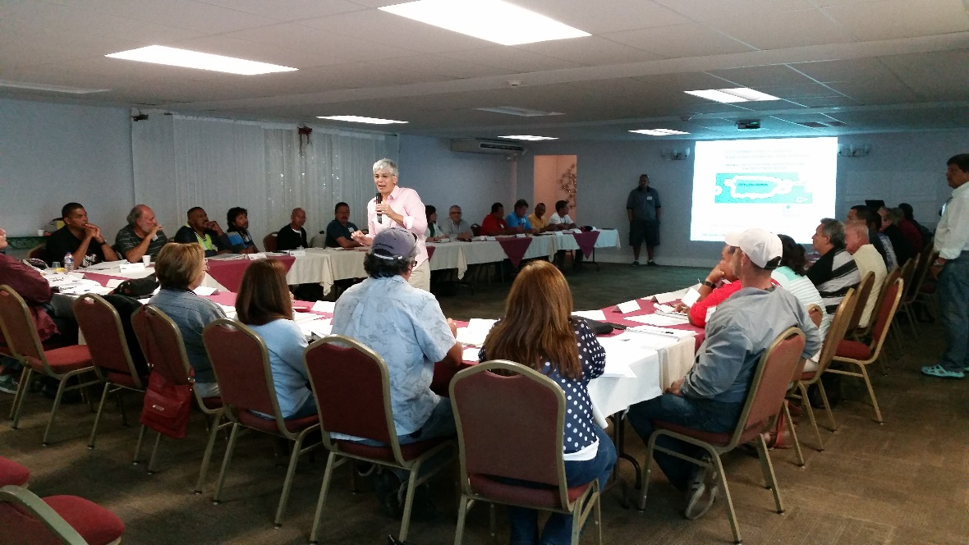
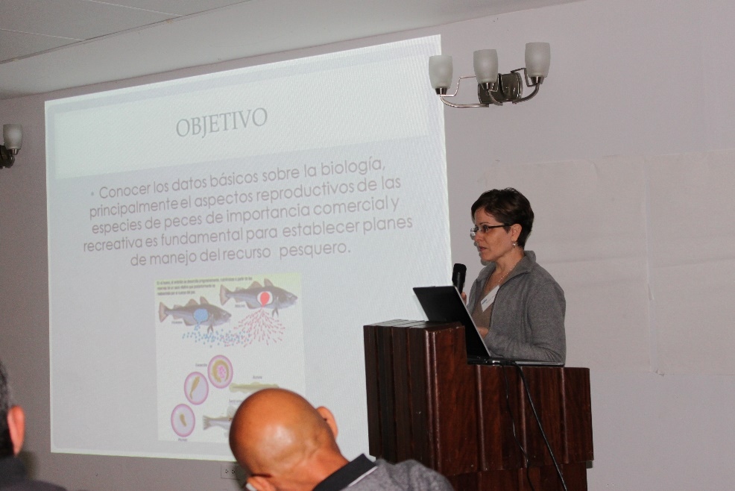
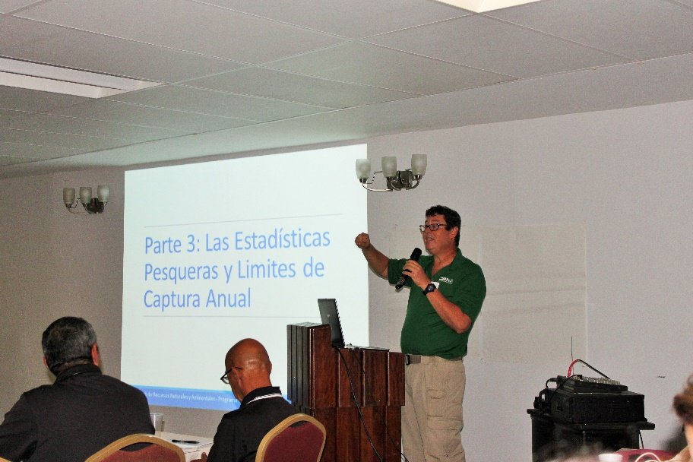
Day 1: Science workshop
Notes:
USCG = US Coast Guard, USCBP = US Customs and Border Protection,

Slide 6
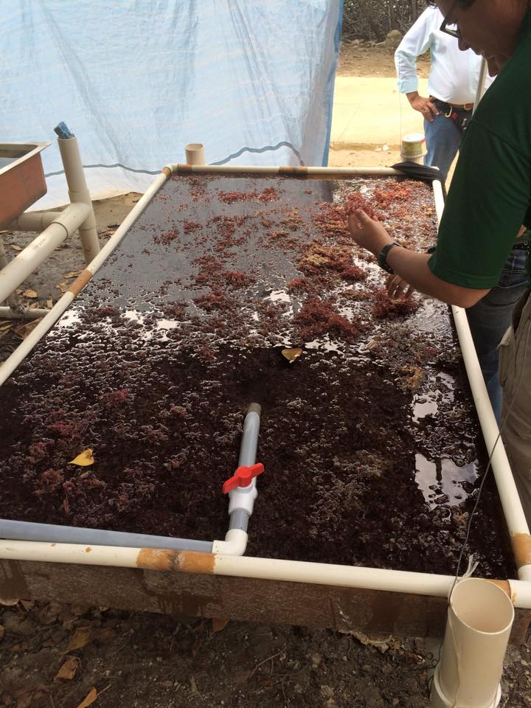
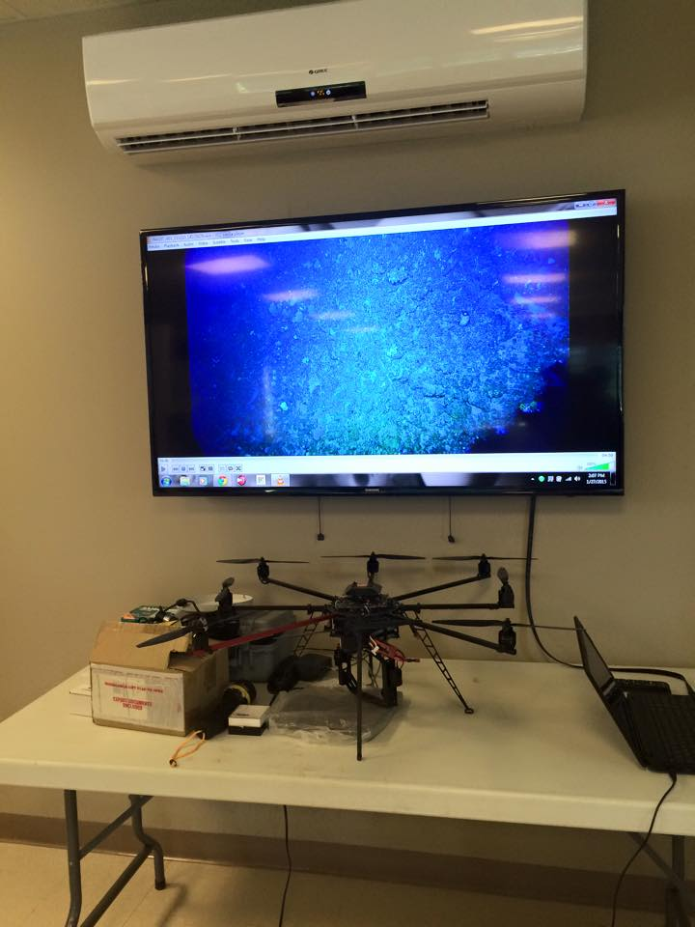
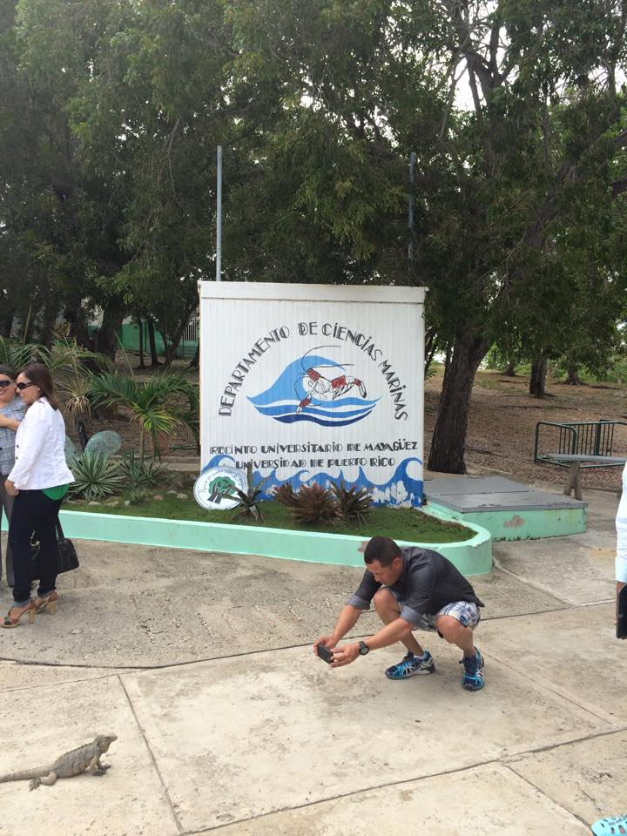
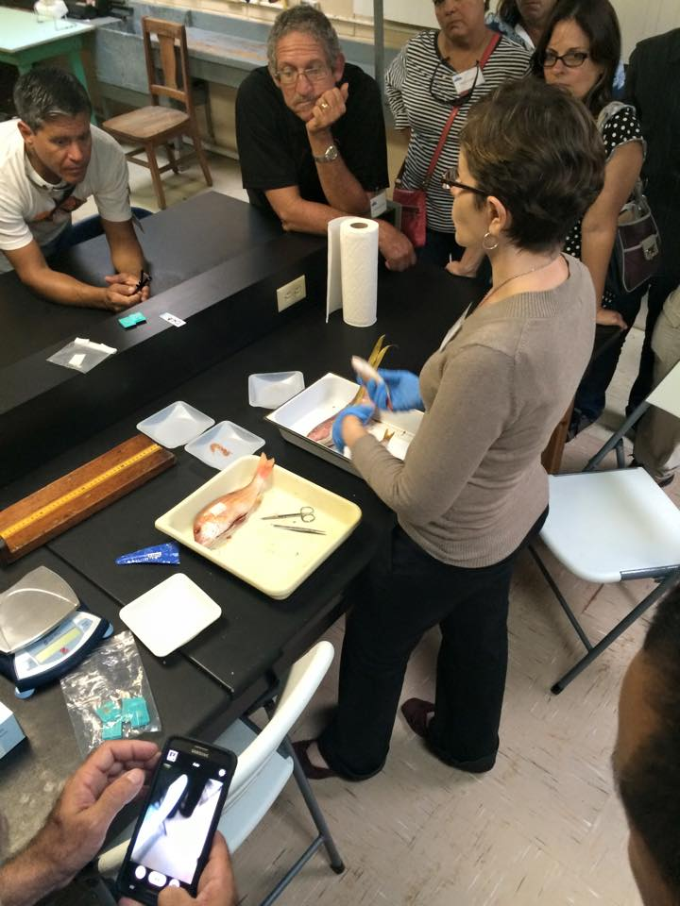
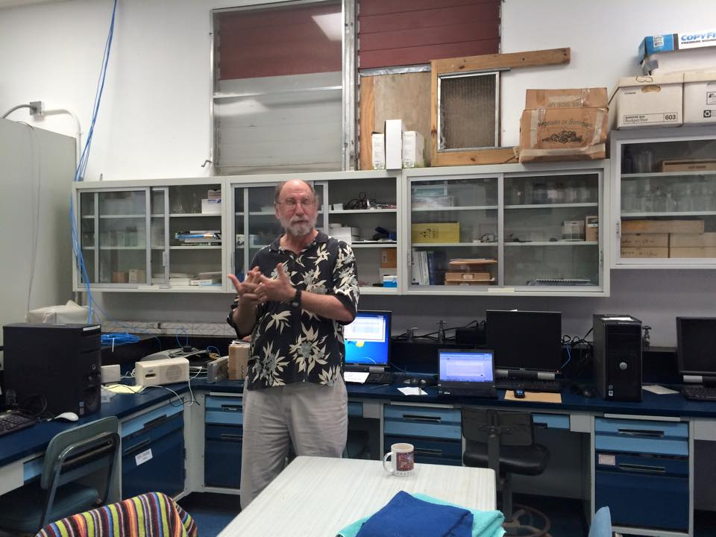
Day 1: Science workshop Field visit
Notes:
Field trip: Department of Marine Sciences on Isla Magueyes. (1) Diadema Restoration Project – Dr. Stacey Williams (2) Bioptics and Remote Sensing Laboratory – Dr. Roy Armstrong (3) Caricoos Ocean Observing Laboratory – Julio Morell (4) CCRI – Dr. Richard Appledoorn (5) Otolith and gonad extraction. Determine age and maturity of fish – Noemi Peña

Slide 7
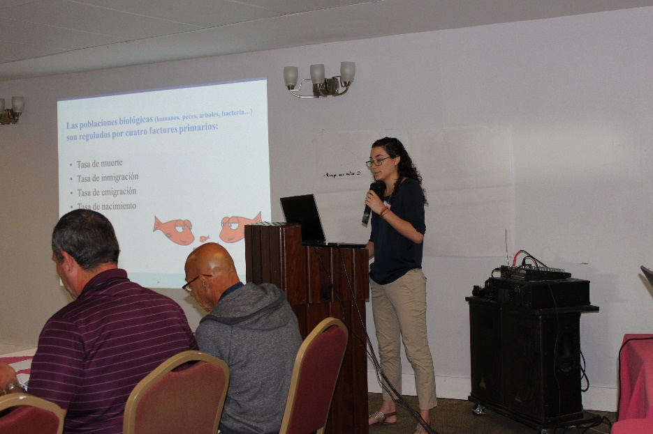
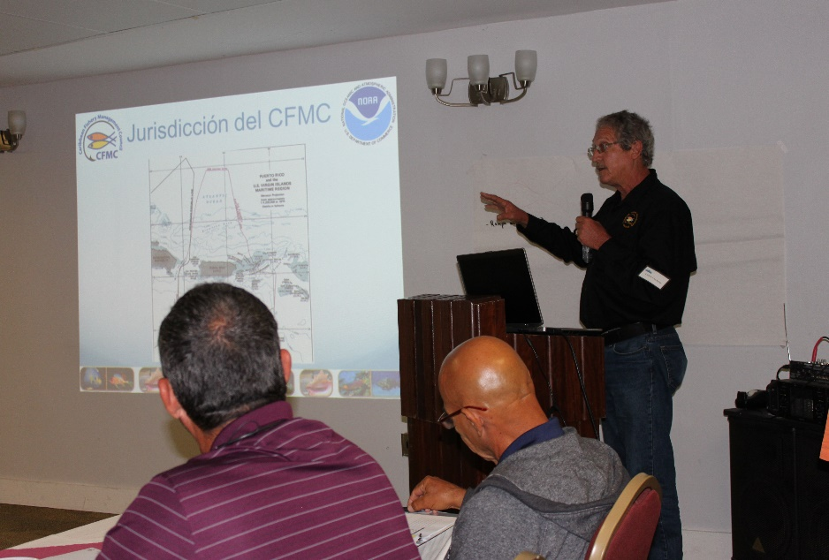
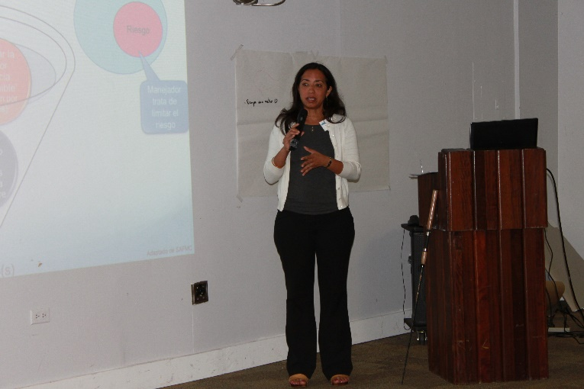
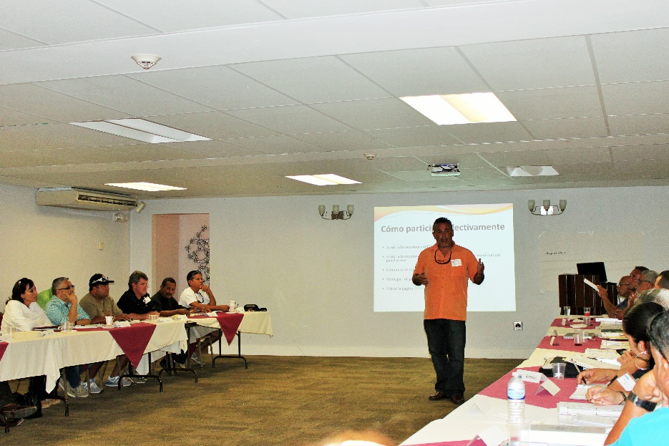
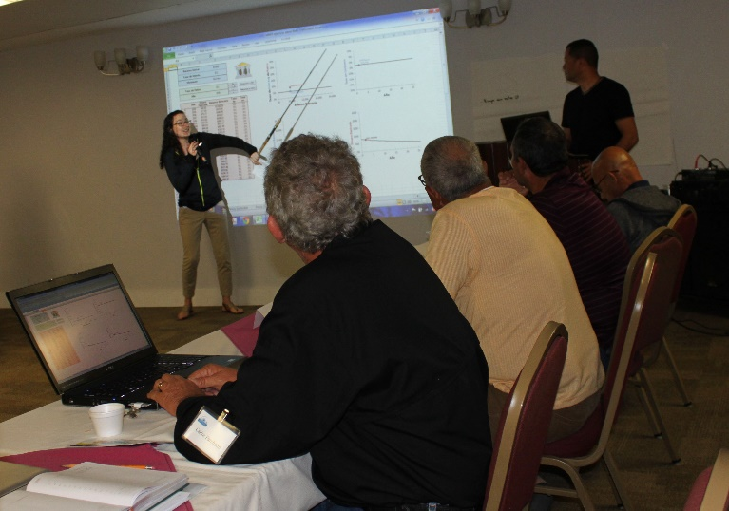
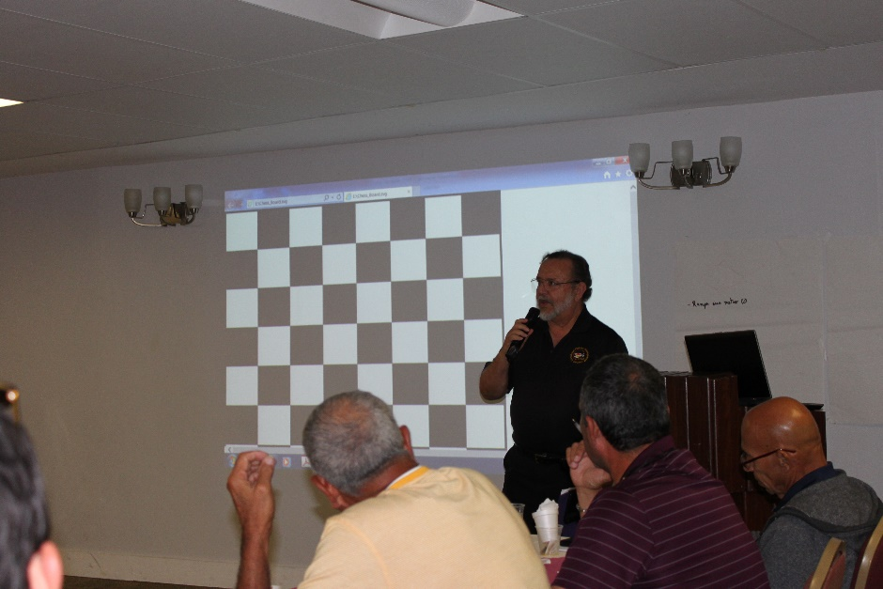
Day 2: management workshop

Slide 8
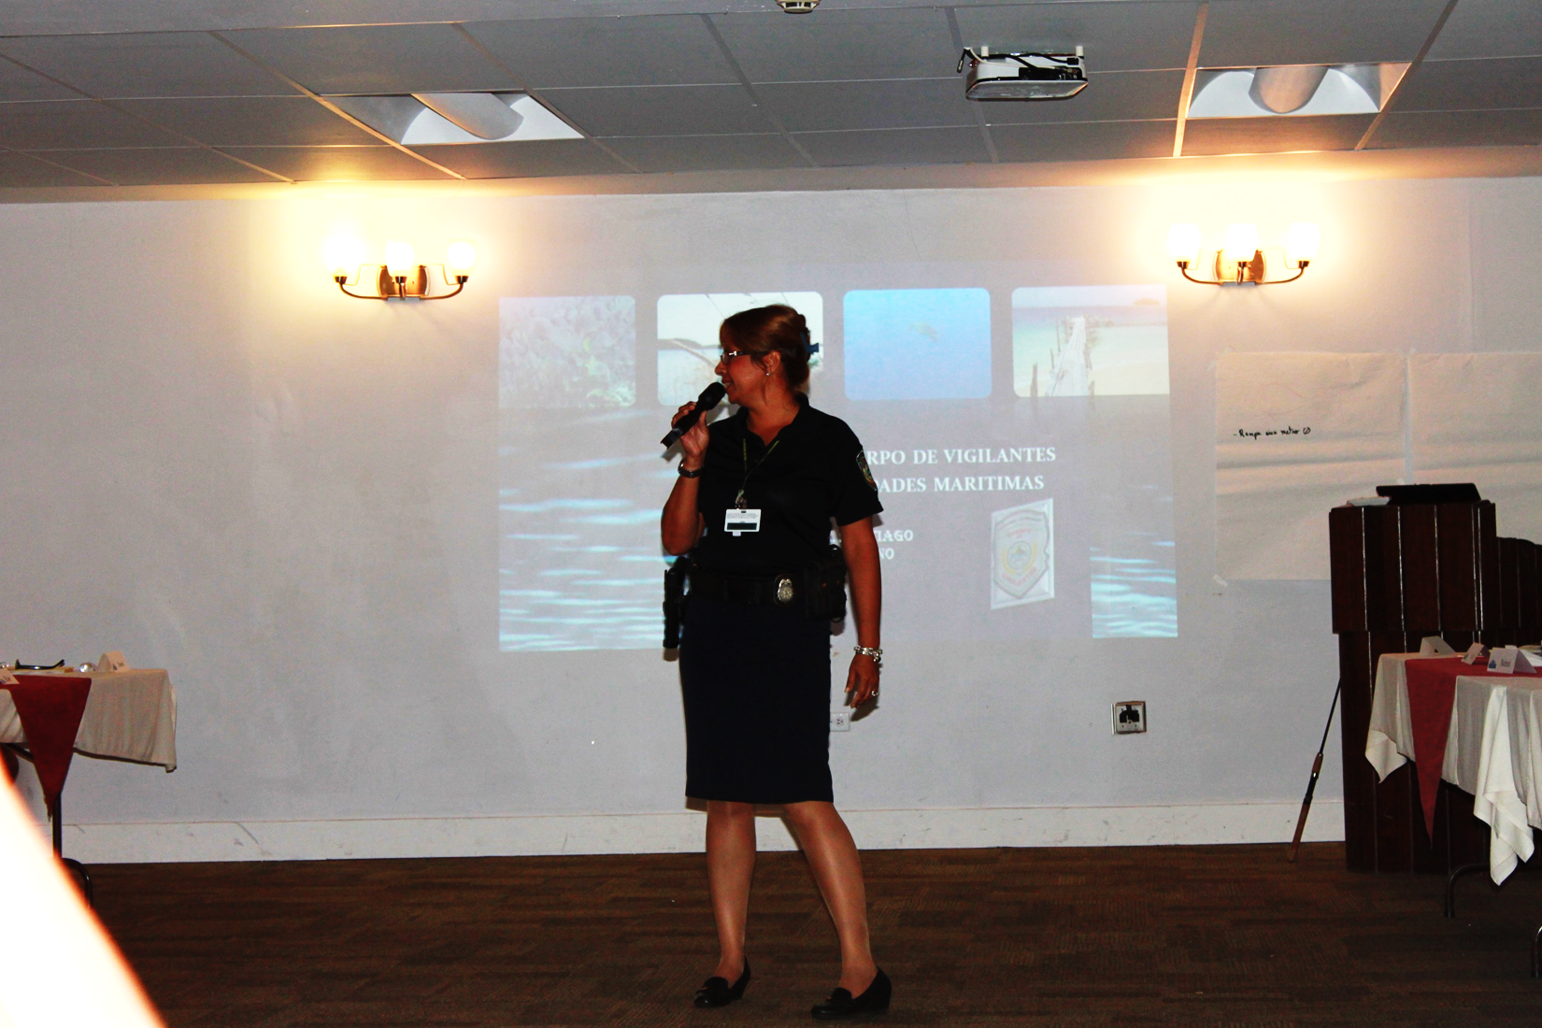
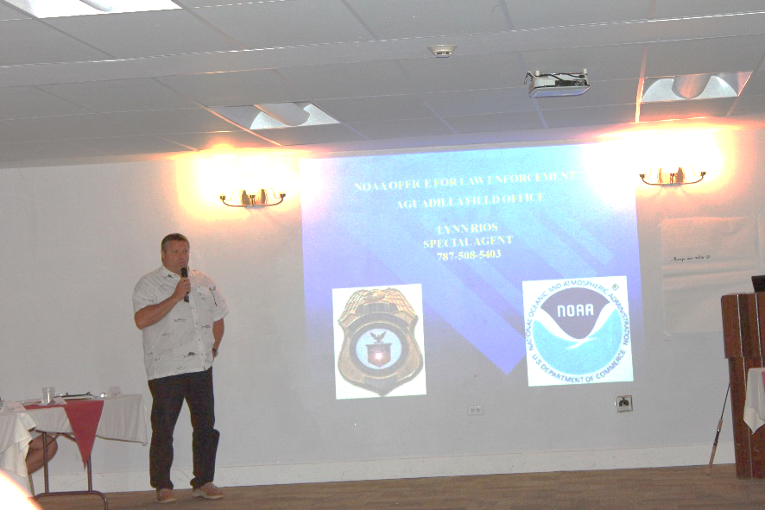
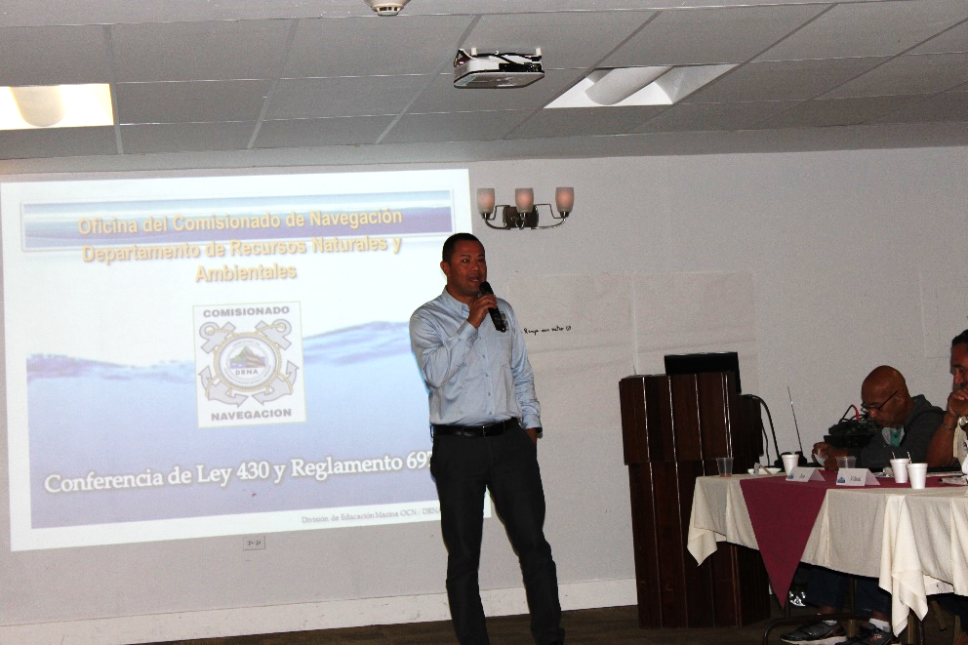
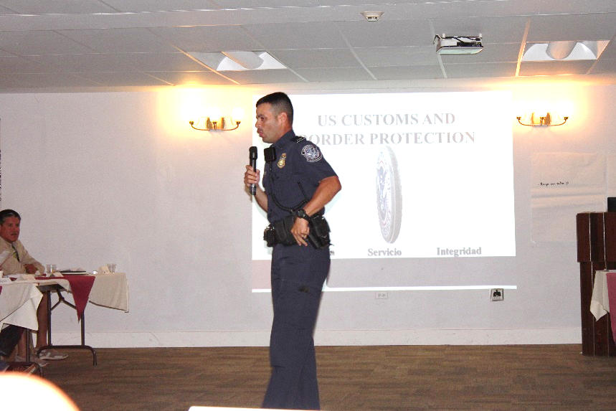
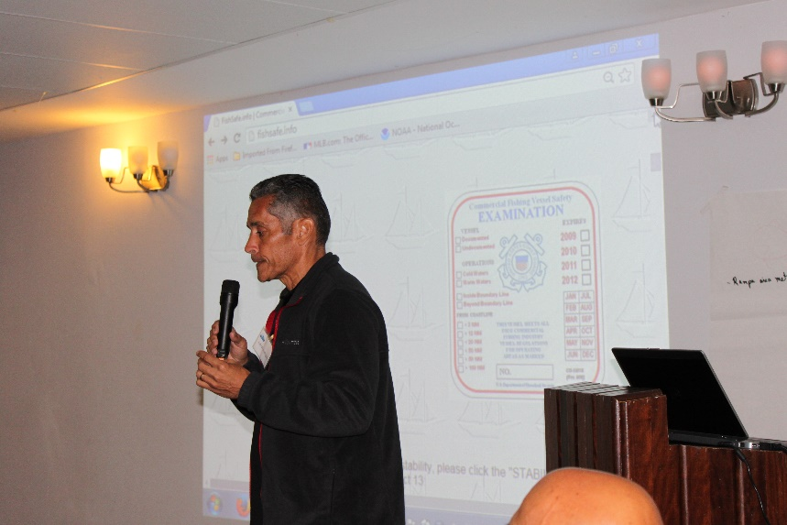
Day 3: law enforcement workshop
Notes:
DRNA-Ranger Corps / NOAA Law Enforcement / US Custom and Border Protection / US Coast Guard / DRNA - Navigation

Slide 9
Participant’s Evaluation and comments
Involvment in Council meetings and processes prior to workshop:
Willingness to participate in the fishery management process as a result of this workshop
“The workshop clarified a lot of questions regarding regulations and the role of the agencies” -Workshop participant
Has your perception of fisheries management changed as a result of this workshop?
“Yes, but only as long as fishermen continue to be involved in the process” -Workshop participant
Not involved | 2 | 3 | 4 | Very involved
9% | 14% | 23% | 18% | 36%
Not likely | 2 | 3 | 4 | Very likely
0% | 0% | 9% | 0% | 91%
Notes:
Una muestra de los comentarios y evaluaciones

Slide 10
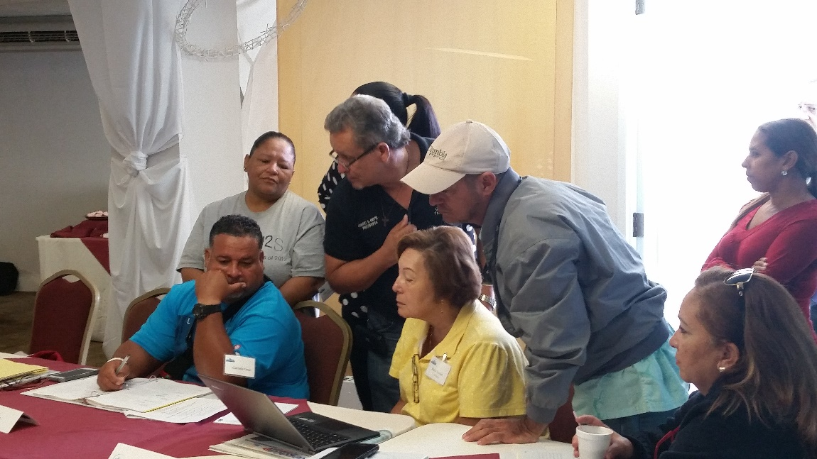
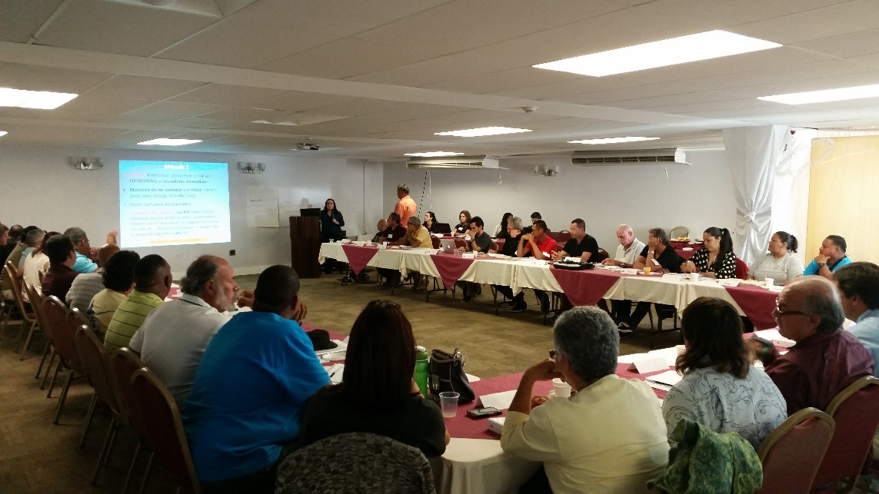
Next Steps
Plans to hold Steering Committee meeting to discuss results and outcomes
Tentative dates: May-june
MREP 2016
Puerto Rico?
USVI?
Notes:
La idea era que el proximo MREP fuese en Islas Virgenes pero hay mucha demanda en PR. Posiblemente lo hacemos otra vez en PR, mientras tanto en el USVI podemos ir hablando con los pescadores introduciendo el concepto del workshop y planificar algo para finales del 2016 o principios del 2017.

Slide 11
